Slide 1

Sorter Simulation Model in Visual Components
Prepared by,
Sooraj Sunil
DC-AT (ESP1)

Slide 2
Problem Statement
Introduction
We want to evaluate the design of an efficient sorting system to handle mixed flow of products from multiple sources. The goal is to ensure each conveyor line leaving the sorter only contains one type of product.
System Overview :
Sources :
4 sources producing 4 different product types : Product A, B, C & D.
Each source generates a random mixture of all 4 products.
Each source produces all the product types with 25% probability.

Slide 3
System Overview :
Product distribution :
Product A : 25% each from Source 1,2,3,4
Product B : 25% each from Source 1,2,3,4
Product C : 25% each from Source 1,2,3,4
Product D : 25% each from Source 1,2,3,4
The product type arrival at each source is random and follows no particular pattern.

Slide 4
System Overview :
Conveying System:
Input : Mixed products are conveyed one by one in 4 conveyor lines from sources to a central sorting station.
Output: After sorting each of the 4 conveyor will only have one type of product in it.

Slide 5
Four sources, each producing 25% of all four product types
Schematic representation
1
2
3
4
SORTER
Each product line after sorting having only one type of product
A
B
C
D

Slide 6
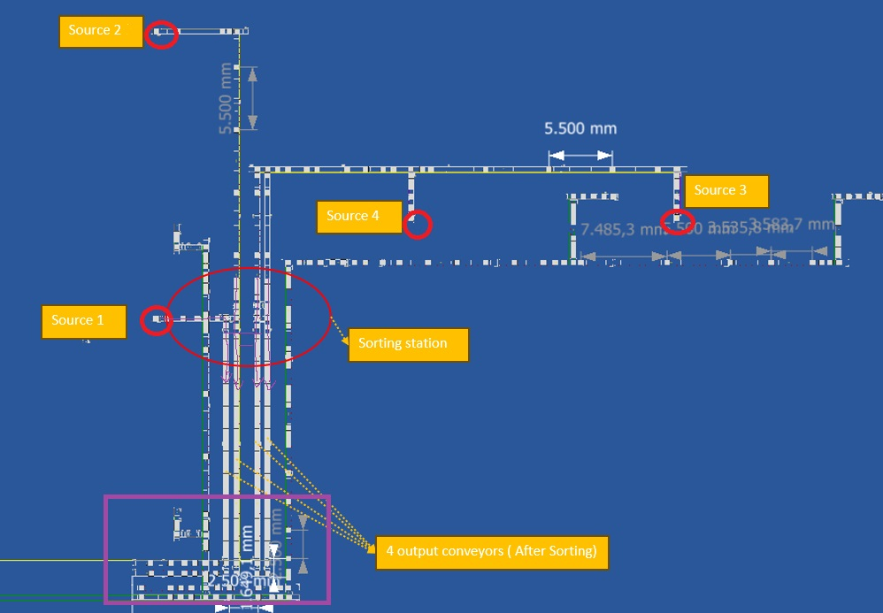
MTPro Layout:

Slide 7
Design Challenge
Design and model an efficient sorting system in Visual Components keeping the cycle time (performance constraint) and costs (design constraint ) in mind.
Modelling sources that produces random product mix with the required distributions.

Slide 8
Methodology
Sorting Strategy development
Develop a sorting strategy to efficiently separate the products into distinct product types.
In each of the conveying lines in the sorting area, there are decision points where sorting decisions can be executed.
The system can be improved by systematically increasing the no. of decision points, thereby enhancing overall flexibility.
Increasing the no. of decision points enhances overall system flexibility and reduces queue formation at sorting points, at the expense of increased cost and complexity.
This trade-off between cost and cycle time must be carefully considered in the system design.

Slide 9
General Design Concepts
1. Horizontal Conveyors
The basic configuration of this approach is to have horizontal conveying lines connecting all four conveyors.
1
2
3
4
1
2
3
4
SORTER
- Decision Points
- Bidirectional Product flow
A
B
C
D
A
B
C
D
The product will be sorted based on the sorting logic at each decision points.
Although very simple and cost efficient, the system will have a poor performance due to large queues at different decision points.
9

Slide 10
General Design Concepts
1. Horizontal Conveyors
Sorting logic defines the performance of the system. At each decision point, the basic sorting logic is as follows:
Incoming product type at a decision point
Does the product belong in this conveyor?
OR
Is there space on this conveyor?
Move to adjacent conveyor in proximity to target conveyor
OR
The conveyor has space
NO
YES
To next decision point
Stay on this line and move forward
Decision points are connected to horizontal conveyors, which transfers the product to the intended conveyor.

Slide 11
General Design Concepts
2. Circular Conveyors
The basic configuration of this approach is to connect all four sources to the circular conveyor.
1
2
3
4
- Decision Points
Circular Conveyor
- Product flow direction
A
B
C
D
Circular conveyor can accumulate, circulate and distribute the products to output conveyors.

Slide 12
General Design Concepts
2. Circular Conveyors
At each decision point at the output, the basic sorting logic is as follows:
Incoming product type at a decision point
Does the product type belong in the target conveyor?
AND
Is there space on this conveyor?
YES
Is there an adjacent decision point ?
NO
NO
Product goes into Circulation
YES
Divert the product into product specific output conveyor
Advantages: Continuous flow of products into output conveyors
Challenges: Susceptibility to operational issues when processing large batches of identical products.

Slide 13
General Design Concepts
3. Dead-end buffers
These buffer lines can temporarily store and distribute products to the output line when required.
4
1
2
3
4
SORTER
Buffer lines
A
B
C
D
These lines can be used for pre-sorting the product types before transferring them back when required.

Slide 14
Design of Sorting Area
The design concepts mentioned previously, or a combination thereof, can be utilized to design the simulation model of the sorting area.
Approach 1 : Horizontal Conveyors
Utilize decision points and horizontal conveyors for sorting the products to target conveyors.
Analyze material flow to pinpoint potential blockages or queues within the system.
Implement changes to sorter configuration by repositioning horizontal transfer conveyors to counter the blockages and queues.
Heuristic decomposition by breaking down sorting tasks into smaller, manageable chunks i.e., products types from sources 3 and 4 can be pre-sorted into conveying lines in proximity to the target conveyor.

Slide 15
Design of Sorting Area
In contrast to a single horizontal line connecting all four conveyors, a waterfall sorting configuration, which includes multiple horizontal conveyors at different levels along the vertical conveyor length, can be implemented.
1
2
3
4
- Decision Points
- Direction of Product flow
A
B
C
D
Fig. : Schematic representation of sorting area (Approach 1)
15

Slide 16
Design of Sorting Area
Approach 2 : Circular conveyors
Another approach to this sorting problem is by implementing a circular conveyor replacing the horizontal conveyors.
The circular conveyors can accumulate and circulate the different product types from all 4 sources and finally distribute to the products to the output conveyor.
The entrance from sources to circular conveyor is based on capacity controller logic, which is a simple fill level control for input and output.
The transfer to target is governed by decision points at the entrance of output conveyors.
The product is then transferred to the target product specific conveyor depending on its availability.
If the target conveyor capacity is exceeded, products are circulated along the circular conveyor.

Slide 17
Design of Sorting Area
In addition, bypass lines connecting the sources directly to their target conveyor of a product type can be utilized.
Four sources, each producing 25% of all four product types
1
2
3
4
Bypass lines ( For direct transfer of products to target conveyor)
- Decision Points
Circular Conveyor
- Product flow direction
Each product line after sorting having only one type of product
A
B
C
D
Fig. : Schematic representation of sorting area (Approach 2)

Slide 18
Design of Sorting Area
The fill level control ensures only the specified number of products between the entry and exit points enter the circular conveyor.
The system can push the sorted products into output conveyors and can circulate them if the conveyor capacity is exceeded.
This eliminates the blockage at these decision points allowing latter materials to be sorted instead of waiting in the queue.

Slide 19
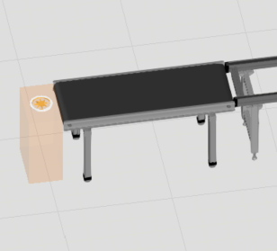
System Modelling
Source :
Four source feeders producing products with `FeedMode´ : Distribution
Interval : 22 sec (Given)
Probability of each product type 25%
Conveying Units :
Conveyor used : Bosch Rexroth TS2- Conveyor Unit.
Modelled based on MTpro layout (Given).

Slide 20
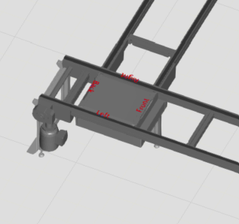
System Modelling
Decision points:
Lift transverse units based on routing rule.
Sorter ( Approach 1):
Combination of conveyor units, Belt Sections and Lift transverse units.
Decision points : Lift transverse unit routing to desired output conveyor based on product type routing rule.

Slide 21
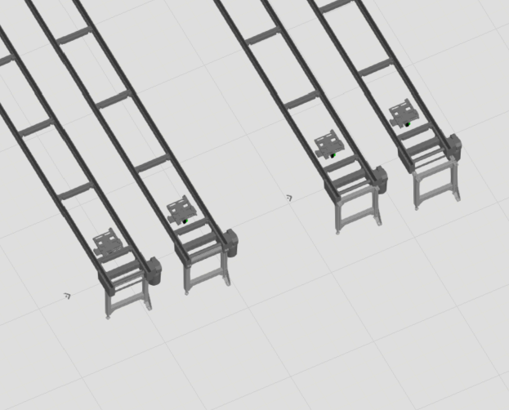
System Modelling
Sorter ( Approach 2):
Combination of conveyor units to form a circular conveyor system.
Decision points : Lift transverse unit routing to desired output conveyor based on product type and capacity routing rule.
Capacity Control nodes at entry/ exit of circular conveyor, to control capacity between entry and exit points.
Processing stations:
Position units at the end of each output conveyors with a process time of 16s.

Slide 22
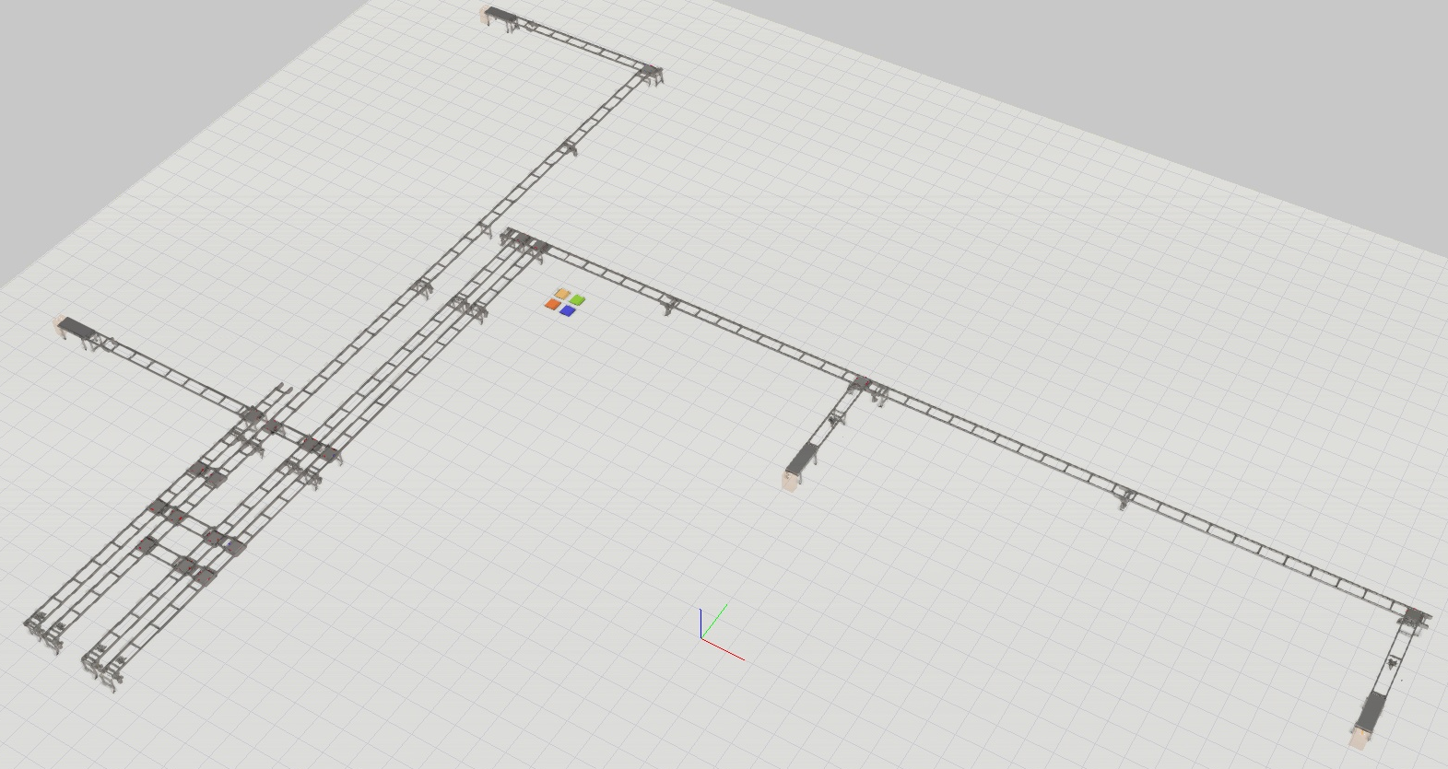
System Modelling (Approach 1)

Slide 23
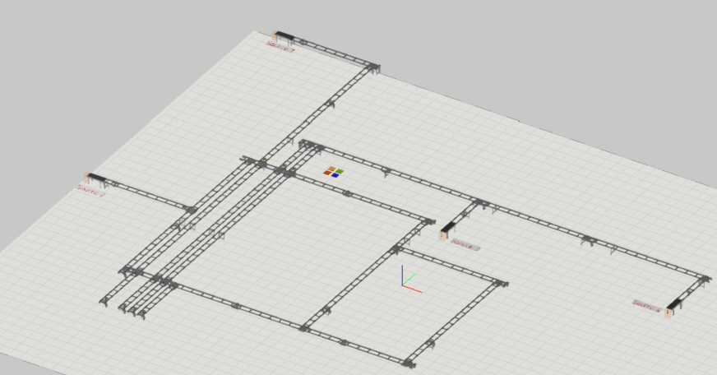
System Modelling (Approach 2)

Slide 24
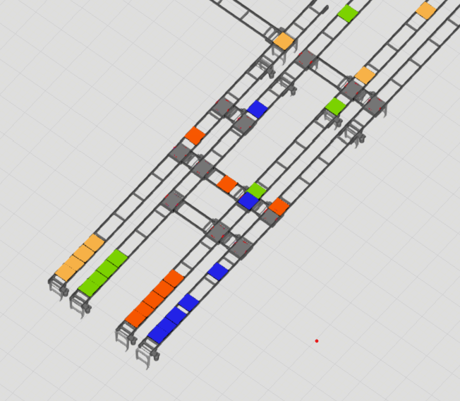
Sorter Configuration (Approach 1)
From Source 1,2
From Sources 3 & 4
Sorting station
Sorted Output

Slide 25
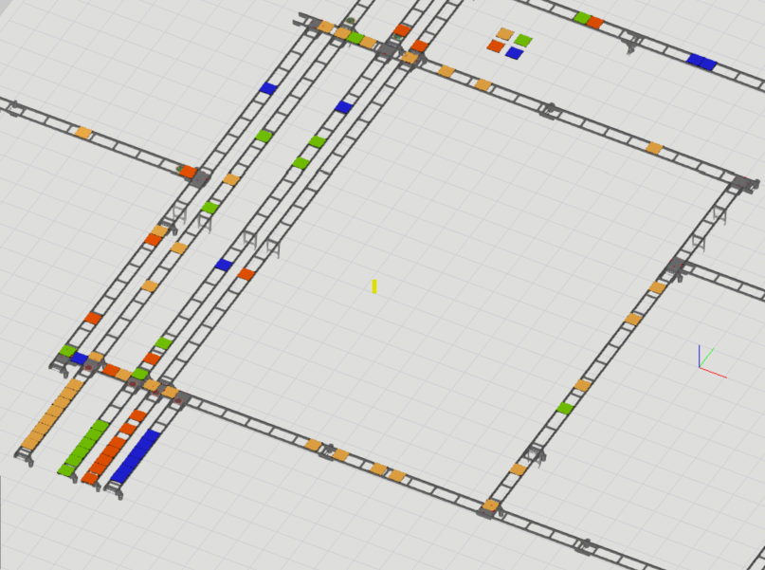
Sorter Configuration (Approach 2)
From Sources
Bypass Lines
Circular Conveyor
Decision Points
Sorted Output

Slide 26
Observations & Results

